Slide 1
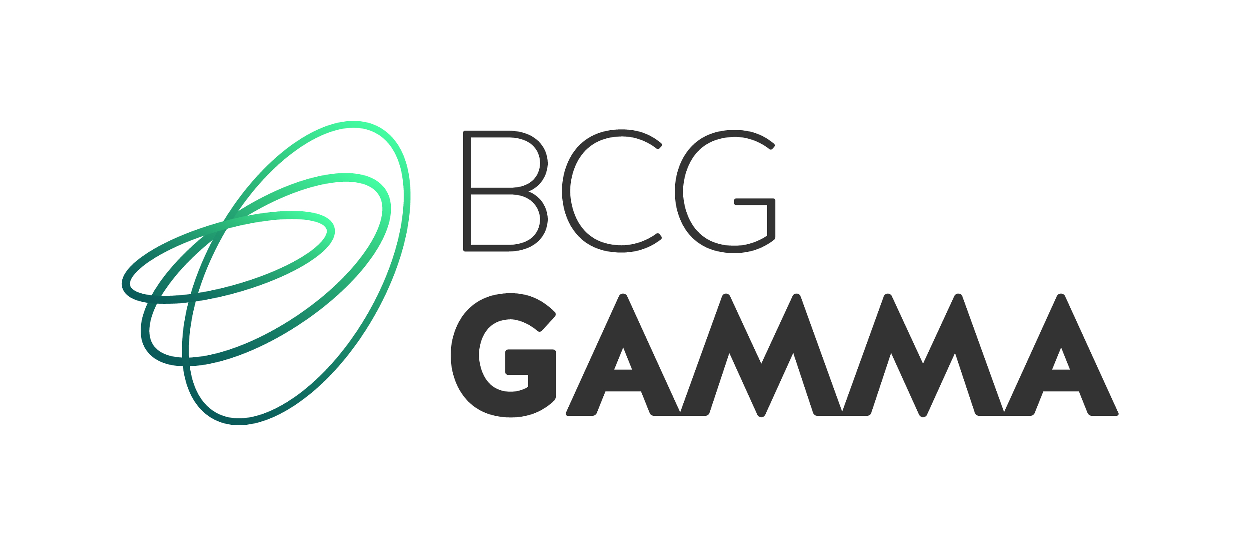
Etude de cas FSF B2B Retail
CentraleSupélec
Lundi 20 JANVIER 2020

Slide 2
ClientCo summary
Company figures: ~15.5 B$ revenues, ~675 M$ EBIT and ~31 300 employees (fiscal year 2018)
Governance
CEO, 58 has been leading ClientCo for 3 years and is likely to remain at his position in the coming years
Chairman, 62 is at the beginning of her second 4 years term and is known to endorse easily CEO's strategy
Publicly traded with no clear shareholder majority
Activity
ClientCo is a global construction and renovation products distributors operating network of branches across Europe, North America and Asia-Pacific
Core business consists in buying products from suppliers and reselling them through network of points of distributions dedicated mostly to B2B channels
Wide product range including small equipment and accessories (abrasives, anchors, blades, brooms, brushed, cables, hammers, masks, ear plugs, extension cords, tapes, fabrics, gloves, hard hats, inserts, lasers, lights, locks, nails, paint rollers, power cords, rakes, paint, hoses, screws, …) to bigger high volume products (power generators, fall protections, ladders, pneumatic tools, repair parts, vapor barrier, weather protection, carts, climate controls, …)
Wide range of suppliers ranging from local to international manufacturing groups
Wide range of customers ranging from small local businesses to global construction groups
Source: Industry reports, brokers notes and BCG analysis

Slide 3
ClientCo's SWOT Analysis
Strengths
Leading supplier of construction solutions and equipment with a strong presence in various markets
Dense network of > 1000 branches in > 15 countries
Wide customer base in diverse end-markets (residential, commercial and industrial). Customer base include contractors, end-users, industrial and tertiary companies, from small professionals to major industrial accounts ; ClientCo has more than 450k active customers
Strong brand portfolio and few own brand products
Multiple sales channels: branches (60%), traveling sales executives, call centers, salesforce, know-how centers, EDI, e-commerce, web-based configurators and applications
Strong performance in Central America
Weaknesses
Performance in decline in Western Europe and in South East Asia which could affect overall business
Limited liquidity reduce ClientCo's ability to fund large projects and threats to cause missed opportunities
Increasing debt portfolio and financial costs
Very weak presence online, almost no sales via e-commerce
Opportunities
Positive outlook of the global construction industry, expected to increase at an annual rate of 3.5% during next 4 years driven by emerging markets and especially China
Strategic restructuring with the disposal of non-essential business and restructuring of operations in selected countries
Signs of data-driven development roadmaps, limited to early phases yet
Threats
Changing regulations with increasing importance of environmental concerns in most geographies and continuously hardening regulations regarding products and disposals which could put ClientCo portfolio at risk, and require frequent assortment reviews
Unfavorable currency fluctuations which could cause increase ClientCo's expenses
Increasing digitization of business and operations exposes ClientCo to cyberattacks and cybersecurity vulnerabilities. Significant attacks could jeopardize company's growth or require significant applications and systems restructuration and incur exceptional costs
Source: Industry reports, brokers notes and BCG analysis

